Slide 1
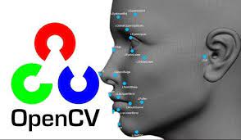
Was ist Open CV?
Bildverarbeitungstool
Gesichts,-Gestenerkennung
Einfache Implementierung
Open Source
Python
OpenCV - Open Computer Vision Library

Slide 2
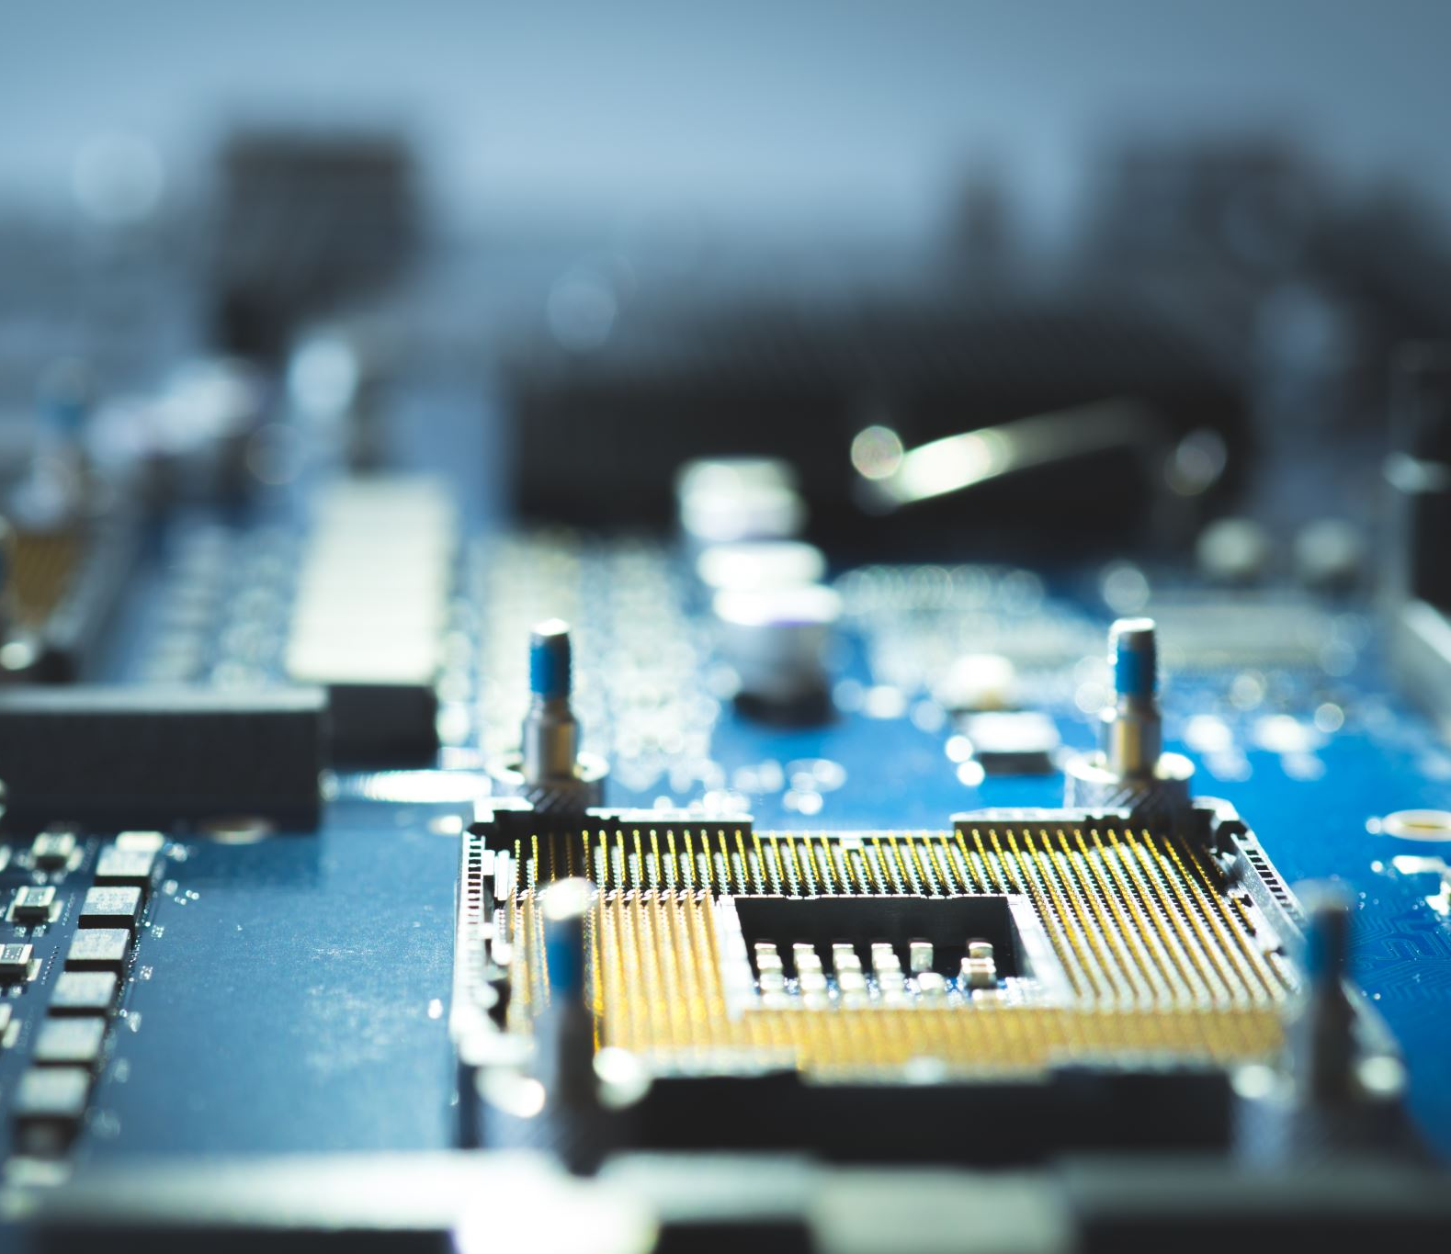
Was wird benötigt?
Kamera (USB, IP, usw…..)
Python
Rechner oder µC

Slide 3
Install Open CV on Windows
OpenCV Tutorial: A Guide to Learn OpenCV in Python (mygreatlearning.com)
Use this command in the command prompt to install OpenCV:
pip install opencv-python
In Python
>>>import cv2
>>>print(cv2.__version__)

Slide 4
Bilder importieren

Slide 5
Rotate the Image
cv2.rotate( src, rotateCode[, dst] )
Parameters:
src: It is the image to be rotated.
rotateCode: It is an enum to specify how to rotate the array.Here are some of the possible values :
cv2.cv2.ROTATE_90_CLOCKWISE
cv2.ROTATE_180
cv2.ROTATE_90_COUNTERCLOCKWISE

Slide 6
Kreis einfügen
cv2.circle(image, center_coordinates, radius, color, thickness)
Example:
import cv2
img = cv2.imread(path,1)
cv2.circle(img,(80,80), 55, (255,0,0), -1) cv2.imshow('image',img) cv2.waitKey(0) cv2.destroyAllWindows()

Slide 7
Rechteck einfügen
cv2.rectangle(image, start_point, end_point, color, thickness)
Example:
import cv2
img = cv2.imread(path,1) cv2.rectangle(img,(15,25),(200,150),(0,255,255),15) cv2.imshow('image',img) cv2.waitKey(0) cv2.destroyAllWindows()

Slide 8
Text einfügen
cv2.putText(img, text, org, font, fontScale color)
Example:
import cv2
font = cv2.FONT_HERSHEY_SIMPLEX
mg = cv2.imread(path,1)
cv2.putText(img,'Dog',(10,500),font, 1,(255,255,255),2) cv2.imshow("image",img)
cv2.waitKey(0)

Slide 9
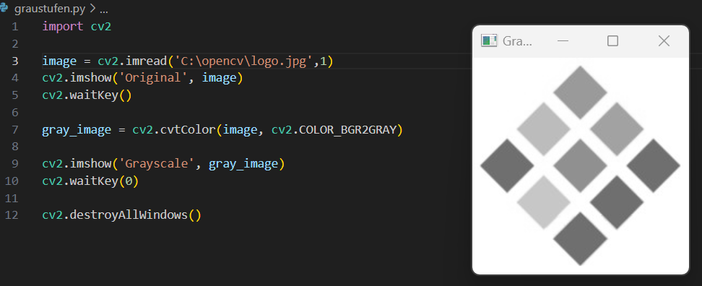
Graustufen von Bildern

Slide 10
Face detection with Viola Jones algorithm
Findet heraus was der Viola Jones-Algorithmus macht und notiert es!
How to Detect Face Recognition using Viola Jones Algorithm (mygreatlearning.com)

Slide 11
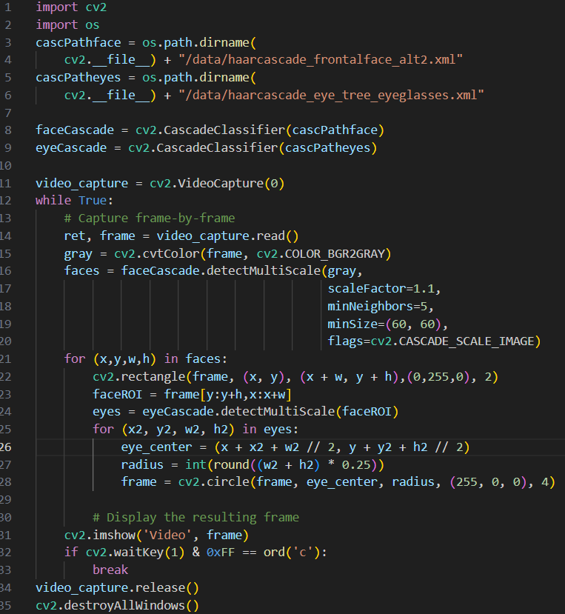
Example Simple Face Detection

Slide 12
Erweiterungen
pip install cvzone
pip install mediapipe
GitHub - cvzone/cvzone: This is a Computer vision package that makes its easy to run Image processing and AI functions. At the core it uses OpenCV and Mediapipe libraries.
Probiert hier mal verschiedene Examples aus und versucht sie zu verstehen!

Slide 13
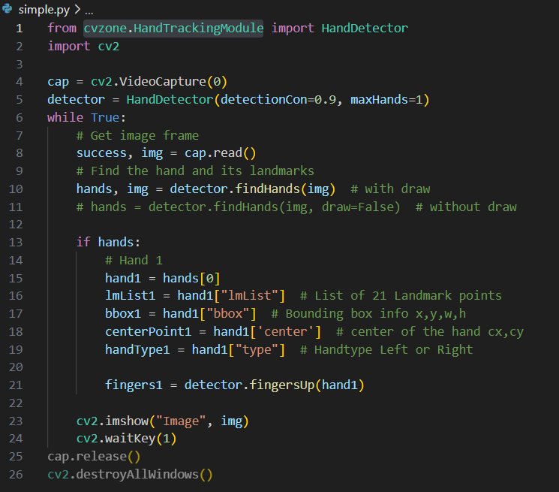
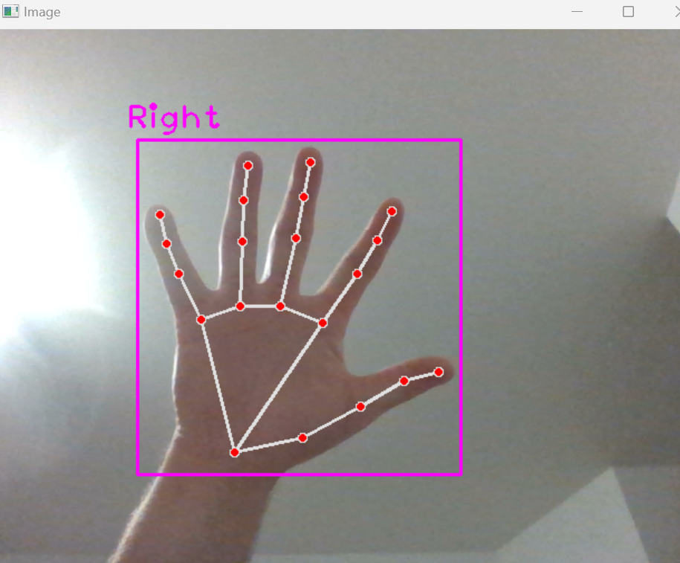
Hand detection

Slide 14
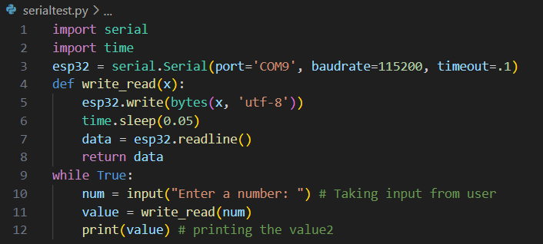
Serielle Verbindung zum µC

